Slide 1

Leveraging ChatGPT for Cooking Solutions
Product Vision, Wireframes & Go-to-Market Strategy
By: Vidhu Jha

Slide 2



Executive Summary
AI-powered assistants such as ChatGPT are fundamentally transforming the way people approach home
cooking by intelligently addressing a wide range of common user pain points, making the entire culinary
experience more accessible and enjoyable.
This innovative solution is specifically designed to meet the diverse needs of busy professionals who require
quick and nutritious meals, health-conscious families managing dietary restrictions and nutrition goals, as well
as adventurous culinary explorers, ensuring broad appeal across multiple user segments.
User-centric design, robust GTM, and seamless integration position ChatGPT Cooking Assistant for market leadership.

Slide 3
Identified Cooking Problems
Decision Overload
Fatigue from constant meal choices
🤔
Cooking Fatigue
Routine drains motivation
😩
Ingredient Anxiety
Stress over unused ingredients
🥦
Overwhelming Recipes
Intimidation by complexity
📜
Dietary Restrictions
Stress Managing allergies/diets
🚫
Time Crunch
Limited time for fresh meals
⏱️
Lack of Cooking Confidence
Self-doubt from inexperience
🧑‍🍳
Food Waste Guilt
Guilt over discarded food
♻️
Health Uncertainty
Confusion over nutrition
🥗

Slide 4
ChatGPT-Powered Use Cases
Decision Overload
Personalized meal suggestions
🍽️
Cooking Fatigue
Weekly plans, creative themes
📅
Ingredient Anxiety
Real time ingredient use tips
🥕
Overwhelming Recipes
Step by step, simplified guidance
👩‍🍳
Dietary Restrictions
Stress Allergy/diet filtering, safe substitutions
🛡️
Time Crunch
Quick meal recommendations
⚡
Lack of Cooking Confidence
Real time encouragement, troubleshooting
💬
Food Waste Guilt
Leftover repurposing, pantry tracking
🗂️
Health Uncertainty
Nutrition analysis, balanced plate suggestions
📊

Slide 5

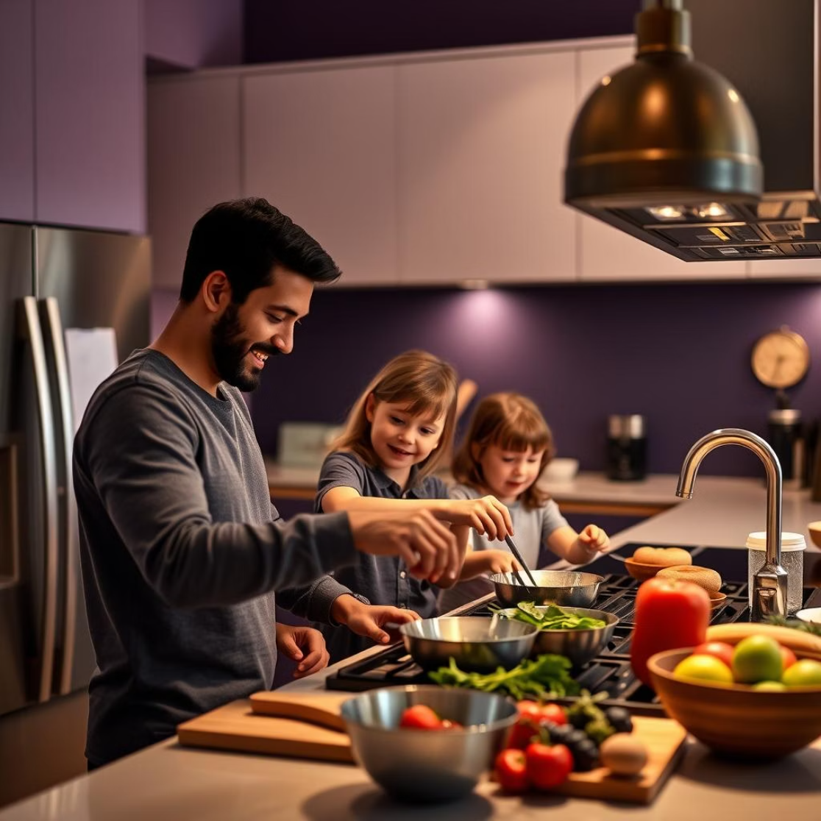
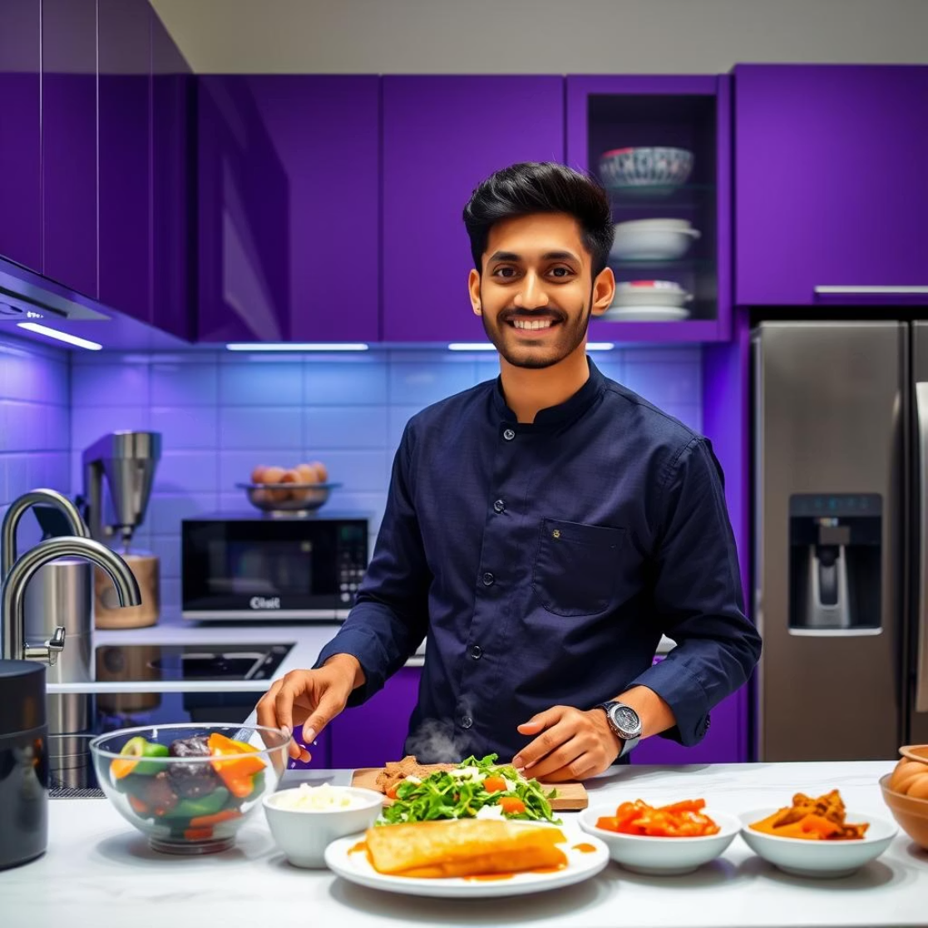
User Personas
Busy Professional (Aisha, 28, Female):
Health-Conscious Parent (Madhav, 37, Male):
Culinary Explorer & Techie (Vidhu, 23, Male):
User Story: "Between client calls and late-night decks, I barely get time to think about meals. I need something healthy, quick, and tailored to my preferences, something that doesn’t require a ton of prep or mental bandwidth."
User Story: "I’m always juggling nutrition with what my kids will actually eat. One child has a nut allergy, and the other is lactose intolerant. So, I need tasty, safe recipes and help staying ahead of meal planning. Bonus if it makes grocery shopping smarter."
User Story: "I love trying global cuisines, but I’m still learning the basics. I want to experiment - make Thai curry today, sourdough next week and so on. I’ve got smart appliances, a smartwatch, and I want my AI chef to vibe with my kitchen."
Key Needs: Fast, healthy meals; automated planning; voice-guided instructions.
Key Needs: Allergen-aware recipes; nutritional analysis; family meal planning.
Key Needs: Global recipes; smart appliance integration; skill-building tips.

Slide 6
Integration Options
Smart Kitchen Appliance
Hands-free, personalized, scalable
🧑‍🍳 + 📱
Standalone Mobile App
Central hub, flexible, accessible
📱
Smart Speaker & Voice Assistant
Instant, hands-free help
🗣️
Web Platform/Browser Extension
Contextual help, no new device needed
💻
Wearable Device Support
Timers, reminders, multitasking
⌚
API for Third-Party Apps
Broad reach, embedded experience
🔗

Slide 7
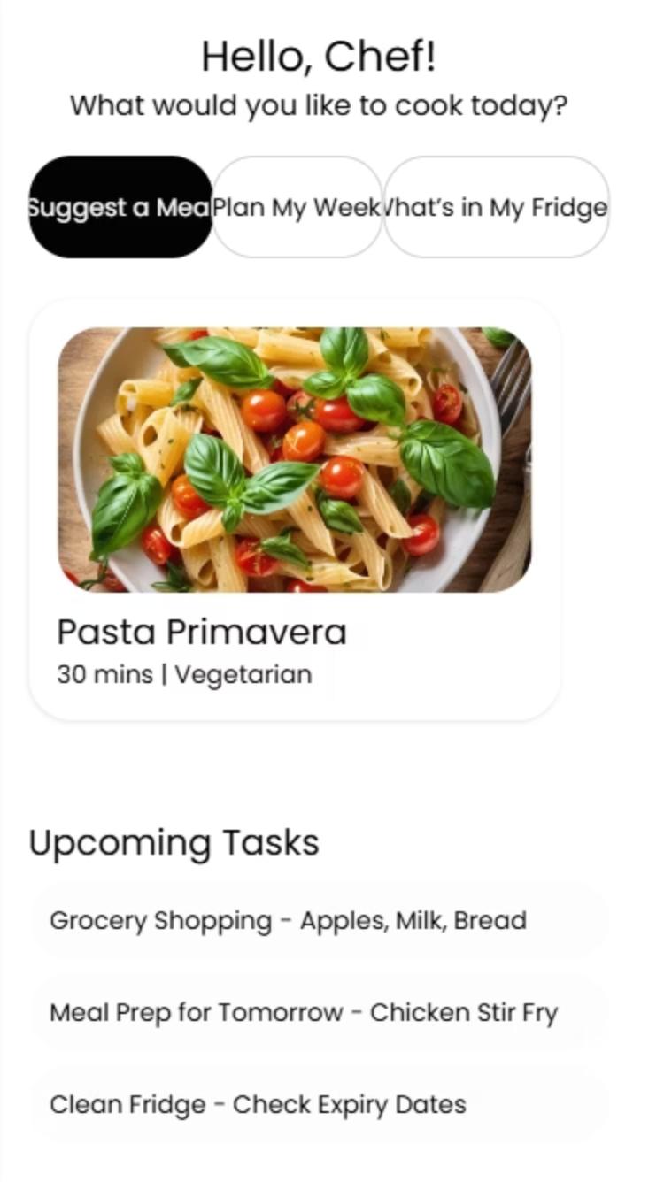
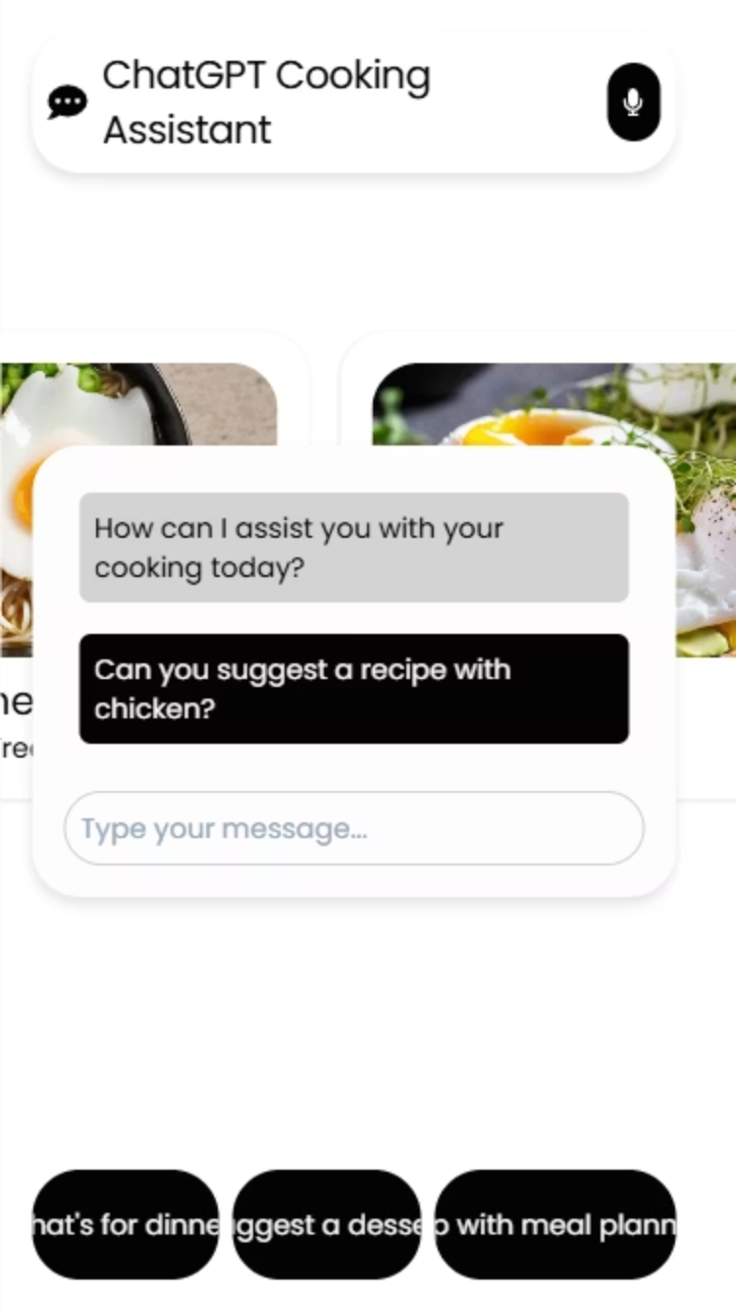
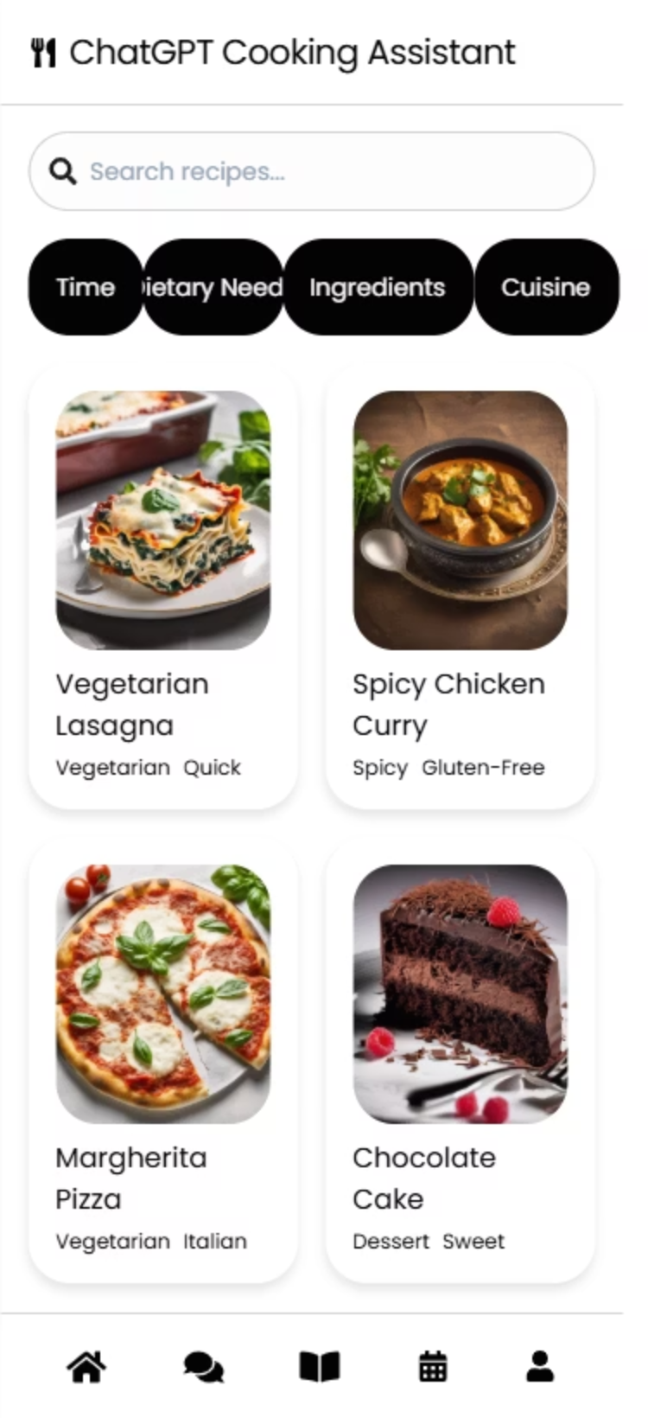
Wireframe Summary (1/2): Home, Chat, Recipe Discovery
Home/Dashboard:
Chat Assistant:
Recipe Discovery:
Functionality: Personalized greeting, quick actions, meal suggestions, reminders
Functionality: Persistent chat, voice input, smart prompts
Functionality: Search, filters, recipe cards

Slide 8
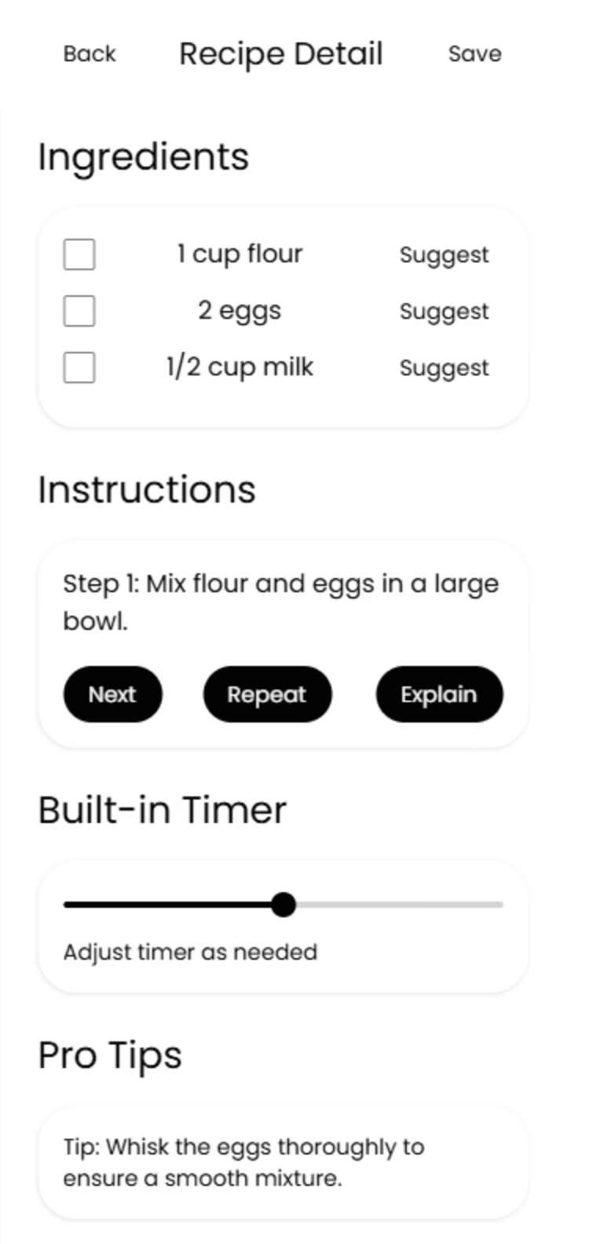
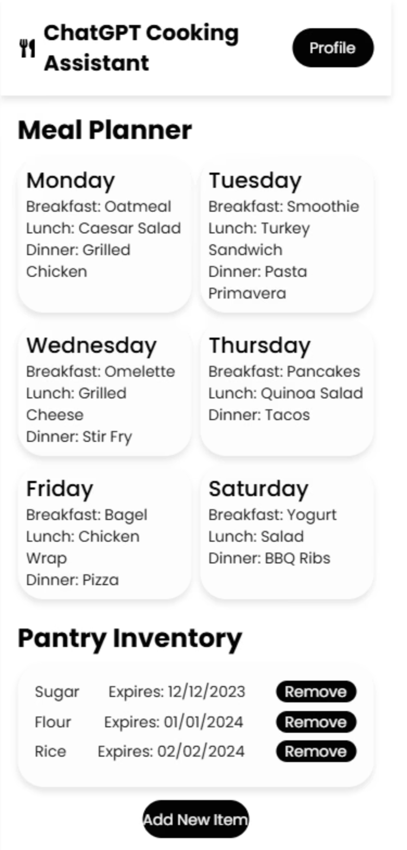
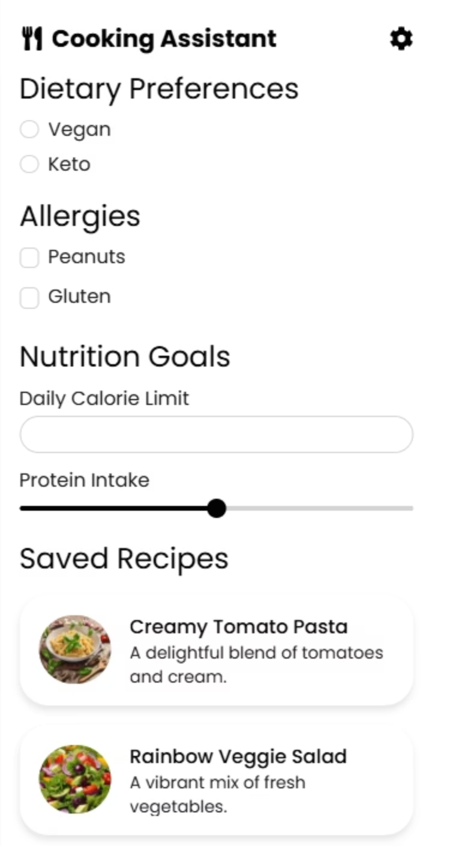
Wireframe Summary (2/2): Recipe Detail, Meal Planning, Profile
Recipe Detail/Step-by-Step:
Meal Planning:
Profile:
Functionality: Dietary settings, appliance integration, saved recipes/history
Functionality: Editable ingredients, step-by-step mode, timers, pro tips
Functionality: Calendar view, auto-generated shopping list, pantry tracker

Slide 9




Go-to-Market Strategy: Objectives, Market Sizing, Differentiation, Pricing
Objectives:
Market Sizing:
500k active users by Year 1
TAM: 1.5B global home cooks with smartphone/internet access
NPS > 60
SAM: 250M tech-savvy, health-conscious users in urban and suburban markets (US, EU, India, East Asia)
$2M ARR by Year 2
SOM(Year 1): Targeting 1M+ early adopters via digital channels and appliance partnerships.
Differentiation:
Pricing:
Most natural, adaptive AI
Freemium model
Personalized for user preferences, dietary needs and kitchen inventory
Premium at $5.99/mo with advanced features like nutrition analysis, allergen filtering etc.
Cross-device for seamless experience
B2B/API licensing fees for appliance partners and health platforms/apps.
Hands-free inclusive design for accessibility

Slide 10



Go-to-Market Strategy: Partnerships, Marketing, Measurement
Partnerships:
Appliance brands
Meal kit/grocery services
Health/fitness apps
Marketing:
Content marketing
SEO/ASO
Influencer campaigns
Referral and loyalty programs
Media Outreach and Industry Events for PR
Measurement:
Track acquisition, retention, conversion, referral, NPS
Continuous feedback loops

